Slide 1

Inconometrics
Prediction of Income using Naive Bayes
Presented By:
Ajay Deshmukh
Darshan Bhansali
Vishwadeep Dutta
Notes:
Econometrics is the quantitative application of statistical and mathematical models using data to develop theories or test existing hypotheses in economics and to forecast future trends from historical data.

Slide 2

In machine learning, naïve Bayes classifiers are a family of simple "probabilistic classifiers" based on applying Bayes' theorem with strong (naïve) independence assumptions between the features.
^{Naive Bayes}
This algorithm is called “Naive” because it makes a naive assumption that each feature is independent of other features which is not true in real life.

Slide 3
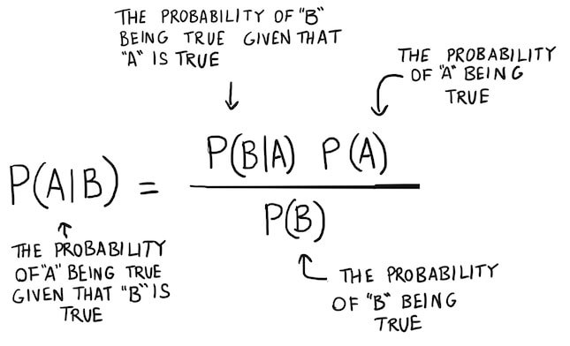
Bayes Theorem

Slide 4
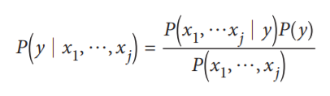
Naive Bayes Classifier formula
P (y | x1, … , xj) = Posterior Probability, Probability of data included in class y given their features x1 until xj.
P (x1, … , xj | y) = Likelihood of features value given that their class is y.
P (y) = Prior Probability.
P (x1, … , xj) = Marginal Probability.

Slide 5
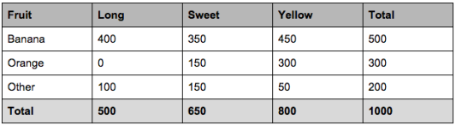
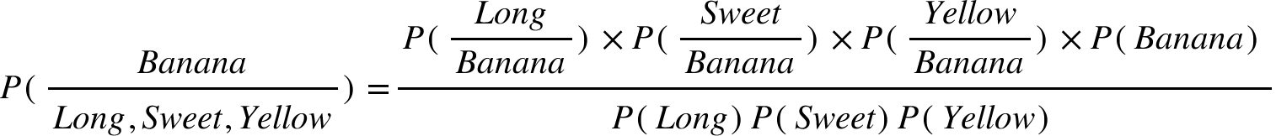


Example

Slide 6
Data Description
Number of records: 48562
Number of columns: 15
Metadata
age | Integer | Continuous
Workclass | String | Categorical
fnlwgt | Integer | Continuous
Education | String | Categorical
education_num | Integer | Continuous
marital_status | String | Categorical
occupation | String | Categorical
relationship | String | Categorical
race | String | Categorical
gender | String | Categorical
capital_gain | Integer | Continuous
capital_loss | Integer | Continuous
hours_per_week | Integer | Continuous
native_country | String | Categorical
income_bracket | String | Categorical
Notes:
we have 15 columns
MOst of them have categorical values but there are few columns with continuous values
We are going to convert the continuous values to categorical values using sliding windows For example we are going to make 4 categories for age group.
We are going to drop the capital gain and capital loss columns because it has mostly zero values which is of no use.
the education-num columns is derived from Education column. In naive bayes we consider all the features to be independent variables thus to normalize the weightage of the column, we are dropping it.

Slide 7
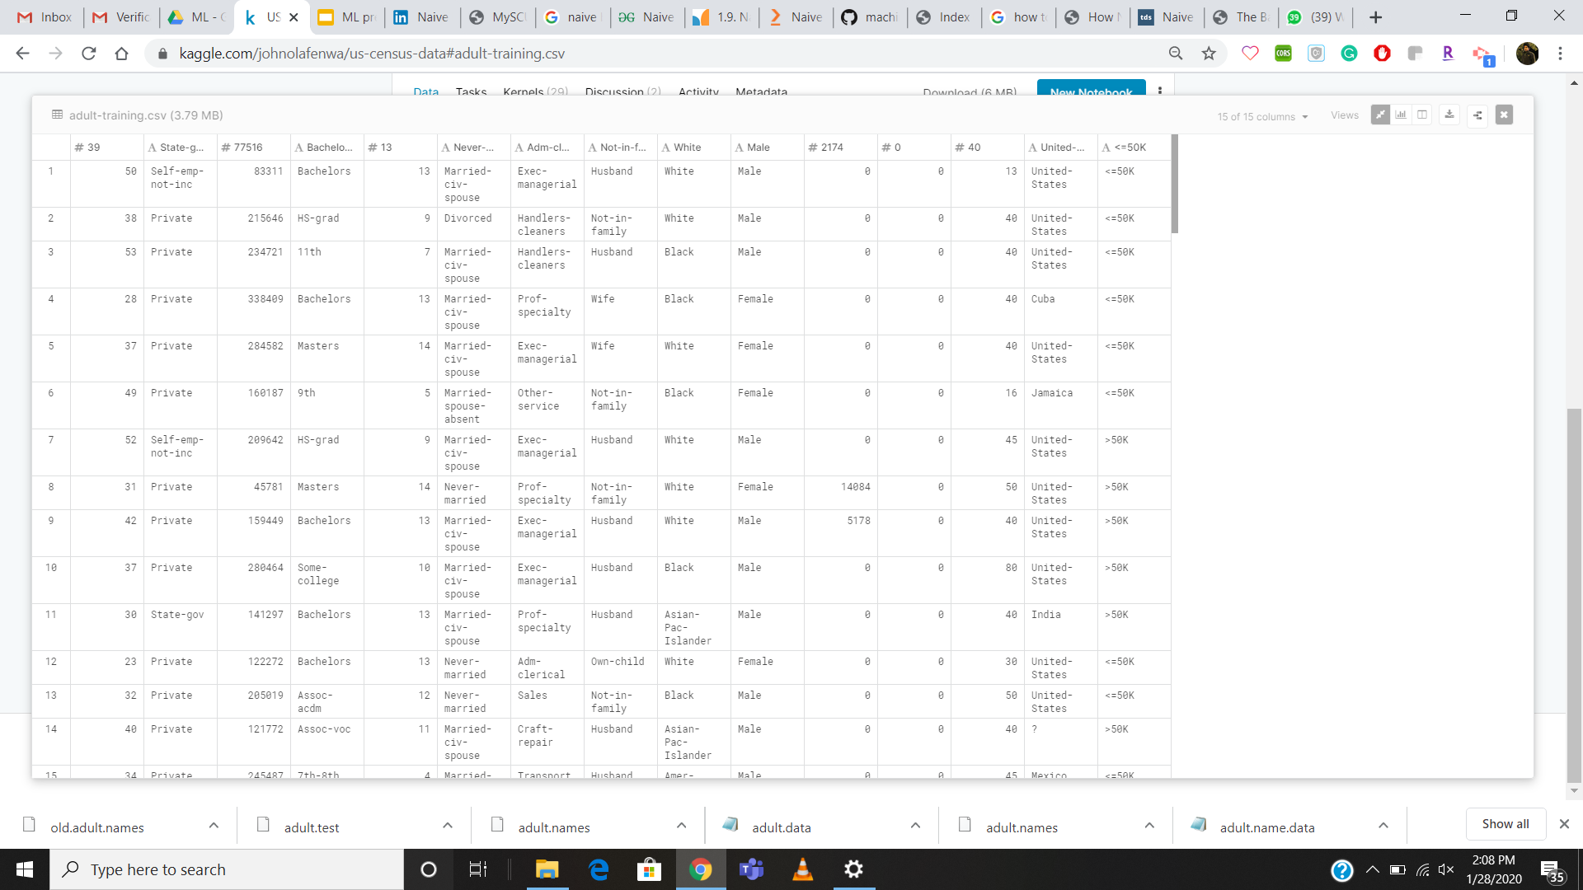
Data

Slide 8
Project Plan
Data collection
Data Cleaning
Applying ML Models
1
2
3
4
5
6
Model Accuracy comparison
Evaluation
Success

Slide 9
Bayesian ML Models We are planning to apply following models and check accuracy of each. Then, accordingly we will finalize one model.
The features/predictors used by the classifier are the frequency of the words present in the document.
Multinomial Naive Bayes
This is similar to the multinomial naive bayes but the predictors are boolean variables.
Bernoulli Naive Bayes
When the predictors take up a continuous value and are not discrete, we assume that these values are sampled from a gaussian distribution
Gaussian Naive Bayes
This is standard Naive bayes from Scikit-learn.
Standard Naive Bayes

Slide 10
Project Evaluation Procedures
Training & testing on same data
Train/test split
K-fold cross-validation
Notes:
Rewards overly complex models that "overfit" the training data and won't necessarily generalize
Split the dataset into two pieces, so that the model can be trained and tested on different data
Better estimate of out-of-sample performance, but still a "high variance" estimate
Useful due to its speed, simplicity, and flexibility
Systematically create "K" train/test splits and average the results together
Even better estimate of out-of-sample performance
Runs "K" times slower than train/test split

Slide 11
Project Evaluation Metrics
Confusion Matrix
Classification Accuracy
Classification Error
1
2
3
4
5
6
Precision
Sensitivity
Specificity
Notes:
Metrics computed from a confusion matrix
-Classification Accuracy: percentage of correct predictions
-Classification Error: percentage of wrong prediction
-Sensitivity: When the actual value is positive
-Specificity: When the actual value is negative
-Precision:When a positive value is predicted,
-

Slide 12
References
https://www.kaggle.com/johnolafenwa/us-census-data
https://archive.ics.uci.edu/ml/datasets/census+income
https://towardsdatascience.com/naive-bayes-intuition-and-implementation-ac328f9c9718
https://www.machinelearningplus.com/predictive-modeling/how-naive-bayes-algorithm-works-with-example-and-full-code/
https://www.ritchieng.com/machine-learning-evaluate-classification-model/
https://towardsdatascience.com/naive-bayes-classifier-81d512f50a7c

Slide 13


THANK YOU
Slide Template: https://24slides.com/templates

